Slide 1
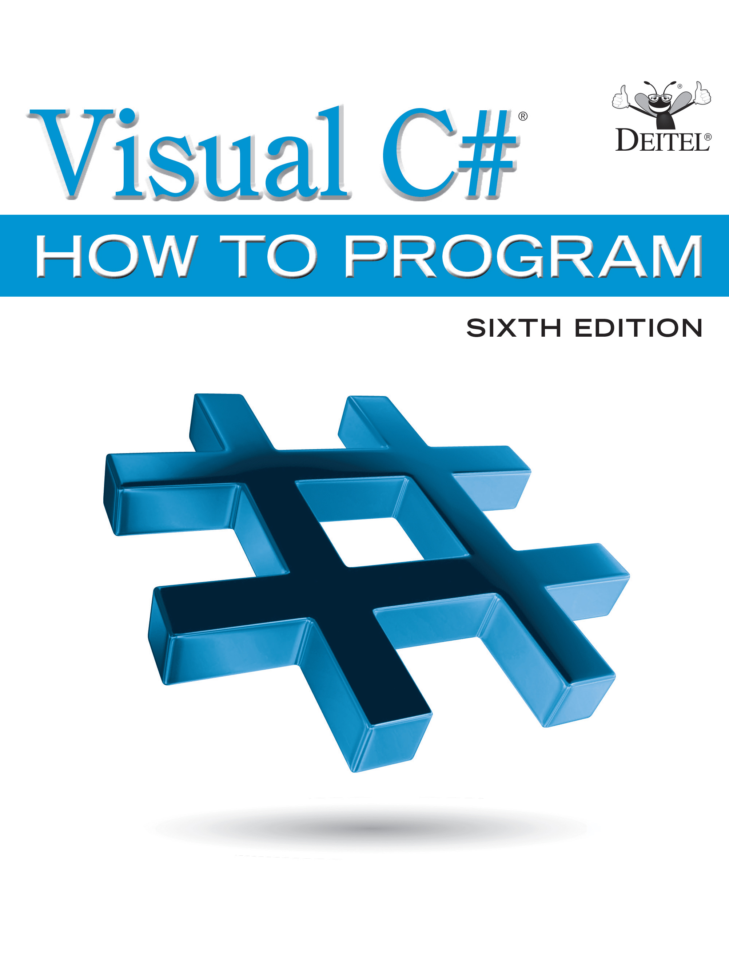
Visual C sharp® How to Program
Sixth Edition
Chapter 7
Methods: A Deeper Look
Slides in this presentation contain hyperlinks. JAWS users should be able to get a list of links by using INSERT+F7
Copyright © 2017 Pearson Education, Inc. All Rights Reserved
Notes:
If this PowerPoint presentation contains mathematical equations, you may need to check that your computer has the following installed:
1) MathType Plugin
2) Math Player (free versions available)
3) NVDA Reader (free versions available)

Slide 2
Learning Objectives (1 of 2)
Learn how static methods and variables are associated with classes rather than objects.
Use common Math class functions.
Learn
argument promotion rules for when argument types do not match parameter types exactly.
Get a high-level overview of various namespaces from the .NET Framework Class Library.
Use random-number generation to implement game-playing apps.

Slide 3
Learning Objectives (2 of 2)
Understand how the visibility of identifiers is limited to specific regions of programs.
Learn how the method call and return mechanism is supported by the method-call stack.
Create overloaded methods.
Use optional and named parameters.
Use recursive methods.
Understand what value types and reference types are.
Pass method arguments by value and by reference.

Slide 4
Chapter Outline (1 of 7)
7.1 Introduction
7.2 Packaging Code in
7.2.1 Modularizing Programs
7.2.2 Calling Methods
7.3 static Methods, static Variables and Class Math
7.3.1 Math Class Methods
7.3.2 Math Class Constants P I and E
7.3.3 Why Is Main Declared static?
7.3.4 Additional Comments About Main

Slide 5
Chapter Outline (2 of 7)
7.4 Methods with Multiple Parameters
7.4.1 Keyword static
7.4.2 Method Maximum
7.4.3 Assembling strings with Concatenation
7.4.4 Breaking Apart Large string Literals
7.4.5 When to Declare Variables as Fields
7.4.6 Implementing Method Maximum by Reusing Method Math.Max
7.5 Notes on Using Methods

Slide 6
Chapter Outline (3 of 7)
7.6 Argument Promotion and Casting
7.6.1 Promotion Rules
7.6.2 Sometimes Explicit Casts Are Required
7.7 The .NET Framework Class Library
7.8 Case Study: Random-Number Generation
7.8.1 Creating an Object of Type Random
7.8.2 Generating a Random Integer
7.8.3 Scaling the Random-Number Ra
7.8.4 Shifting Random-Number Range

Slide 7
Chapter Outline (4 of 7)
7.8.5 Combining Shifting and Scaling
7.8.6 Rolling a Six-Sided Die
7.8.7 Scaling and Shifting Random Numbers
7.8.8 Repeatability for Testing and Debugging
7.9 Case Study: A Game of Chance; Introducing Enumerations
7.9.1 Method RollDice
7.9.2 Method Main’s Local Variables
7.9.3 enum Type Status
7.9.4 The First Roll

Slide 8
Chapter Outline (5 of 7)
7.9.5 enum Type DiceNames
7.9.6 Underlying Type of an enum
7.9.7 Comparing Integers and enum Constants
7.10 Scope of Declarations
7.11 Method-Call Stack and Activation Records
7.11.1 Method-Call Stack
7.11.2 Stack Frames
7.11.3 Local Variables and Stack Fra
7.11.4 Stack Overflow
7.11.5 Method-Call Stack in Action

Slide 9
Chapter Outline (6 of 7)
7.12 Method Overloading
7.12.1 Declaring Overloaded Methods
7.12.2 Distinguishing Between Overloaded Methods
7.12.3 Return Types of Overloaded Methods
7.13 Optional Parameters
7.14 Named Parameters
7.15
6 Expression-Bodied Methods and Properties
7.16 Recursion

Slide 10
Chapter Outline (7 of 7)
7.16.1 Base Cases and Recursive Calls
7.16.2 Recursive Factorial Calculations
7.16.3 Implementing Factorial Recursively
7.17 Value Types vs. Reference Types
7.18 Passing Arguments By Value and By Reference
7.18.1 ref and out Parameters
7.18.2 Demonstrating ref, out and Value Parameters
7.19 Wrap-Up

Slide 11
7.2 Packaging Code in
So far, we’ve used properties, methods and classes to package code.
apps are written by combining your properties, methods and classes with predefined properties, methods and classes available in the .NET Framework Class Library and in other class libraries.
Related classes are often grouped into namespaces and compiled into class libraries so that they can be reused in other apps.

Slide 12
Software Engineering Observation 7.1
Don’t try to “reinvent the wheel.” When possible, reuse Framework Class Library classes and methods (https://msdn.microsoft.com/library/mt472912). This reduces app development time and errors, contributes to good performance and often enhances security.

Slide 13
7.2.1 Modularizing Programs
Methods allow you to modularize an app by separating its tasks into reusable units.
Motivations for modularizing an app with methods
Software reuse—existing methods can be used as building blocks to create new apps.
Avoid repeating code.
Making programs easier to test, debug and maintain
Dividing an app into meaningful methods makes the app easier to debug and maintain.

Slide 14
Software Engineering Observation 7.2
To promote software reusability, every method should be limited to performing a single, well-defined task, and the name of the method should express that task effectively.

Slide 15
7.2.2 Calling Methods
As you know, a method is invoked by a method call, and when the called method completes its task, it returns control and possibly a result to its caller.
An analogy to the method-call-and-return structure is the hierarchical form of management (Figure 7.1).
The boss method does not know how the worker method performs its designated tasks.
The worker may also call other worker methods.
This hiding of implementation details promotes good software engineering.

Slide 16
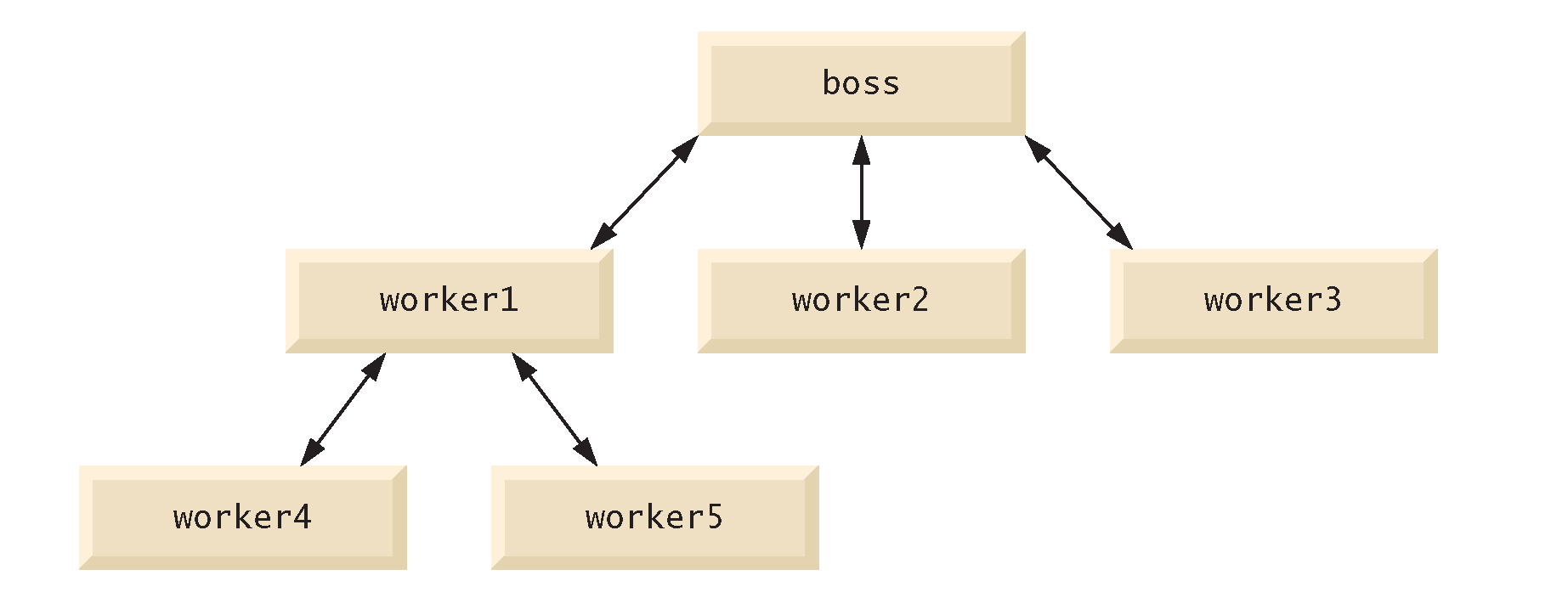
Figure 7.1 Hierarchical Boss-Method/Worker-Method Relationship

Slide 17
7.3 Static Methods, Static Variables and Class Math (1 of 2)
A method that applies to the class in which it’s declared as a whole is known as a static method.
To declare a method as static, place the keyword static before the return type in the method’s declaration.
You call any static method by specifying the name of the class in which the method is declared, followed by the member access (·) operator and the method name.

Slide 18
7.3.1 Math Class Methods (1 of 2)
Class Math provides a collection of static methods that enable you to perform common mathematical calculations.
You do not need to create a Math object before calling method Sqrt.
Method arguments may be constants, variables or expressions.

Slide 19
7.3.1 Math Class Methods (2 of 2)
Figure 7.2 summarizes several Math class methods. In the figure, x and y are of type double.

Slide 20
Figure 7.2 Math Class Methods (1 of 2)
Method | Description | Example
Abs(x) | absolute value of x | Abs(23.7) is 23.7 Abs(0.0) is 0.0 Abs(-23.7) is 23.7
Ceiling(x) | rounds x to the smallest integer not less than x | Ceiling(9.2) is 10.0 Ceiling(-9.8) is -9.0
Floor(x) | rounds x to the largest integer not greater than x | Floor(9.2) is 9.0 Floor(-9.8) is -10.0
Cos(x) | trigonometric cosine of x (x in radians) | Cos(0.0) is 1.0
Sin(x) | trigonometric sine of x (x in radians) | Sin(0.0) is 0.0
Tan(x) | trigonometric tangent of x (x in radians) | Tan(0.0) is 0.0

Slide 21
Figure 7.2 Math Class Methods (2 of 2)
Method | Description | Example
Exp(x) | exponential method E to the x power | Exp(1.0) is 2.71828 Exp(2.0) is 7.38906
Log(x) | natural logarithm of x (base e) | Log(Math.E) is 1.0 Log(Math.E * Math.E) is 2.0
Max(x, y) | larger value of x and y | Max(2.3, 12.7) is 12.7 Max(-2.3, -12.7) is -2.3
Min(x, y) | smaller value of x and y | Min(2.3, 12.7) is 2.3 Min(-2.3, -12.7) is -12.7
Pow(x, y) | x raised to the power y I e, x to the y power | Pow(2.0, 7.0) is 128.0 Pow(9.0, 0.5) is 3.0
Sqrt(x) | square root of x | Sqrt(900.0) is 30.0

Slide 22
7.3 Static Methods, Static Variables and Class Math (2 of 2)
When objects of a class containing static variables are created, all the objects of that class share one copy of the class’s static variables.
Together the static variables and instance variables represent the fields of a class.

Slide 23
Common Programming Error 7.1
Constants declared in a class, but not inside a method or property, are implicitly static—it’s a syntax error to declare such a constant with keyword static explicitly.

Slide 24
7.3.3 Why is Main Declared Static?
Main is sometimes called the app’s entry point.
Declaring Main as static allows the execution environment to invoke Main without creating an instance of the class.

Slide 25
7.3.4 Additional Comments About Main
You can place a Main method in every class you declare.
Some programmers take advantage of this to build a small test app into each class they declare.
If you declare more than one Main method among the classes of your project, you’ll need to indicate to the I D E which one you would like to be the app’s entry point:
With the project open in Visual Studio, select Project → [ProjectName] Properties... (where [ProjectName] is the name of your project).
Select the class containing the Main method that should be the entry point from the Startup object list box.

Slide 26
7.4 Methods with Multiple Parameters (1 of 2)
Figure 7.3 declares method Maximum which determines and returns the largest of three double values.

Slide 27
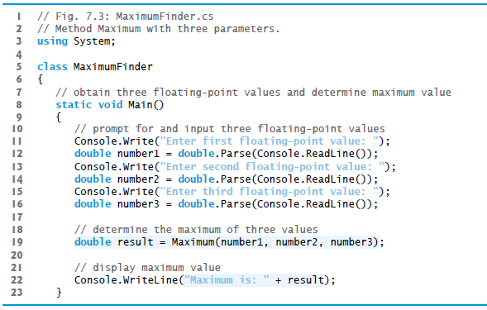
Figure 7.3 Method Maximum with Three Parameters (1 of 3)

Slide 28
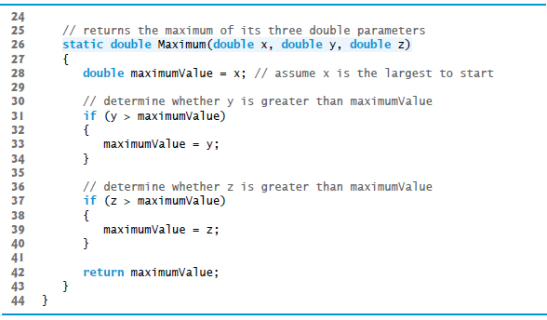
Figure 7.3 Method Maximum with Three Parameters (2 of 3)

Slide 29
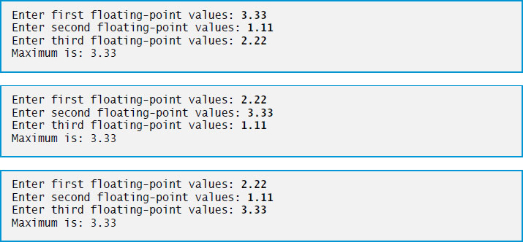
Figure 7.3 Method Maximum with Three Parameters (3 of 3)

Slide 30
7.4.1 Keyword Static
Method Maximum’s declaration begins with keyword static, which enables the Main method (another static method) to call Maximum as shown in line 19 without creating an object of class MaximumFinder and without qualifying the method name with the class name MaximumFinder.
Static methods in the same class can call each other directly.

Slide 31
7.4.2 Method Maximum
When a method has more than one parameter, the parameters are specified as a comma-separated list.
There must be one argument in the method call for each required parameter (sometimes called a formal parameter) in the method declaration.
Each argument must be consistent with the type of the corresponding parameter.
When program control returns from a method, that method’s parameters are no longer accessible in memory.
Methods can return at most one value.

Slide 32
7.4 Methods with Multiple Parameters (2 of 2)
When to Declare Variables as Fields of a Class
Variables should be declared as fields of a class only if they are required for use in more than one method or if the app needs to save their values between calls to the class’s methods.

Slide 33
Common Programming Error 7.2
Declaring method parameters of the same type as double x, y instead of double x, double y is a syntax error—a type is required for each parameter in the parameter list.

Slide 34
7.4.3 Assembling Strings with Concatenation (1 of 3)
string concatenation allows you to combine strings using operator +.
When one of the + operator’s operands is a string, the other is implicitly converted to a string, then the two are concatenated.
If a bool is concatenated with a string, the bool is converted to the string “True” or “False”.

Slide 35
7.4.3 Assembling Strings with Concatenation (2 of 3)
string concatenation allows you to combine strings using + .
When one of the + operator’s operands is a string, the other is implicitly converted to a string, then the two are concatenated.
If a bool is concatenated with a string, the bool is converted to the string “True” or “False”.
Every object has a ToString method that returns a string representation of that object.
When an object is concatenated with a string, the object’s ToString method is called implicitly to obtain the string representation of the object. If the object is null, an empty string is written.

Slide 36
7.4.3 Assembling Strings with Concatenation (3 of 3)
If a type does not define a ToString method, the default ToString implementation returns a string containing the type’s fully qualified name.
Each type you create can declare a custom ToString (Chapter 8).
Line 22 of could also be written using string interpolation as
As with string concatenation, using string interpolation to insert an object into a string implicitly calls the object’s ToString method to obtain the object’s string representation.

Slide 37
7.4.4 Breaking Apart Large String Literals
A large string literal in a program can be broken into several smaller strings and placed them on multiple lines for readability, and reassembled using string concatenation

Slide 38
Common Programming Error 7.3
It’s a syntax error to break a string literal or interpolated string across multiple lines of code. If a string does not fit on one line, you can split it into several smaller strings and use concatenation to form the desired string.

Slide 39
Common Programming Error 7.4
Confusing the string concatenation + operator with the addition + operator can lead to strange results. The + operator is left-associative. For example, if y has the int value 5, the expression
result in the string
because first the value of y (5) is concatenated with the string
then the value 2 is concatenated with the new larger string
The expression
produces the desired result
6 string interpolation eliminates this problem.

Slide 40
7.4.5 When to Declare Variables as Fields
Variables should be declared as fields of a class (i.e., as either instance variables or static variables) only if they’re required for use in more than one method of the class or if the app should save their values between calls to a given method.

Slide 41
7.4.6 Implementing Method Maximum by Reusing Method Math.Max
The entire body of our maximum method could also be implemented with nested calls to Math.Max, as follows:
Before any method can be called, the .NET runtime evaluates all its arguments to determine their values.
Math.Max(y, z) is evaluated first, then the result is passed as the second argument to the other call to Math.Max

Slide 42
7.5 Notes on Using Methods (1 of 3)
Three ways to call a method:
Using a method name by itself to call a method of the same class
Maximum(number1, number2, number3)
Using a reference to an object, followed by the member-access operator (·) and the method name to call a non-static method of the referenced object
account1.Deposit(depositAmount)
Using the class name and the member-access operator (.) to call a static method of a class
Console.ReadLine()
Math.Sqrt(900.0)

Slide 43
7.5 Notes on Using Methods (2 of 3)
Three ways to return control to the statement that calls a method.
Reaching the end of the method.
A return statement without a value.
A return statement with a value.

Slide 44
Common Programming Error 7.5
Declaring a method outside the body of a class declaration or inside the body of another method is a syntax error.

Slide 45
Common Programming Error 7.6
Redeclaring a method parameter as a local variable in the method’s body is a compilation error.

Slide 46
Common Programming Error 7.7
Forgetting to return a value from a method that should return one is a compilation error. If a return type other than void is specified, the method must use a return statement to return a value, and that value must be consistent with the method’s return type. Returning a value from a method whose return type has been declared void is a compilation error.

Slide 47
7.5 Notes on Using Methods (3 of 3)
A static method or property can call only other static methods or properties of the same class directly and can manipulate only static variables in the same class directly.
To access a class’s non-static members, a static method or property must use a reference to an object of that class.
Many objects of a class, each with its own copies of the instance variables, may exist at the same time.

Slide 48
Software Engineering Observation 7.3
A static method cannot access non-static members of the same class directly.

Slide 49
7.6 Argument Promotion and Casting
Argument promotion is the implicit conversion of an argument’s value to the type that the method expects to receive.
These conversions generate compile errors if they don’t follow
promotion rules; these specify which conversions can be performed without losing data.
An int can be converted to a double without changing its value.
A double cannot be converted to an int without loss of data.
Converting large integer types to small integer types (e.g., long to int) can also result in changed values.
The types of the original values remain unchanged.

Slide 50
7.6.1 Promotion Rules
Figure 7.4 lists the simple types alphabetically and the types to which each can be promoted.

Slide 51
Figure 7.4 Implicit Conversions Between Simple Types
Type | Conversion types
bool | no possible implicit conversions to other simple types
byte | ushort, short, uint, int, ulong, long, decimal, float or double
char | ushort, int, uint, long, ulong, decimal, float or double
decimal | no possible implicit conversions to other simple types
double | no possible implicit conversions to other simple types
float | double
int | long, decimal, float or double
long | decimal, float or double
sbyte | short, int, long, decimal, float or double
short | int, long, decimal, float or double
uint | ulong, long, decimal, float or double
ulong | decimal, float or double
ushort | uint, int, ulong, long, decimal, float or double

Slide 52
7.6.2 Sometimes Explicit Casts Are Required
All simple types can also be implicitly converted to type object.
In cases where information may be lost, you must use a cast operator to force the conversion.

Slide 53
Common Programming Error 7.8
Converting a simple-type value to a value of another simple type may change the value if the promotion is not allowed. For example, converting a floating-point value to an integral value may introduce truncation errors (loss of the fractional part) in the result.

Slide 54
7.7 The .NET Framework Class Library (1 of 2)
Predefined classes are grouped into categories of related classes called namespaces.

Slide 55
7.7 The .NET Framework Class Library (2 of 2)
Throughout the text, using directives allow us to use library classes from the Framework Class Library without specifying their namespace names.
An app would include the declaration
using System;
in order to use the class names from the System namespace without fully qualifying their names.
This allows you to use the unqualified name Console, rather than the fully qualified name System.Console, in your code.

Slide 56
Software Engineering Observation 7.4
compiler does not require using declarations in a source-code file if the fully qualified class name is specified every time a class name is used. Most programmers prefer the more concise programming style enabled by using declarations.
The

Slide 57
7.7 The .NET Framework Class Library (1 of 3)
There’s a special relationship between classes in a project
By default, such classes are in the same namespace and can be used by other classes in the project.
Thus, a using declaration is not required when one class in a project uses another in the same project.
Also, any classes that are not explicitly placed in a namespace are implicitly placed in the so-called global namespace.

Slide 58
7.7 The .NET Framework Class Library (2 of 3)
A strength of
is the large number of classes in the namespaces of the .NET Framework Class Library.
Some key Framework Class Library namespaces are described in Figure 7.5.

Slide 59
Figure 7.5 .NET Framework Class Library Namespaces (a subset) (1 of 3)
Namespace | Description
System.Windows.Forms | Contains the classes required to create and manipulate G U I s. (Various classes in this namespace are discussed in Chapter 14, Graphical User Interfaces with Windows Forms: Part 1, and Chapter 15, Graphical User Interfaces with Windows Forms: Part 2.)
System.Windows.Controls System.Windows.Input System.Windows.Media System.Windows.Shapes | Contain the classes of the Windows Presentation Foundation for G U I s, 2-D and 3-D graphics, multimedia and animation. (See the online W P F chapters.)
System.Linq | Contains the classes that support Language Integrated Query (L I N Q). (See Chapter 9, Introduction to L I N Q and the List Collection, and several other chapters throughout the book.)

Slide 60
Figure 7.5 .NET Framework Class Library Namespaces (a subset) (2 of 3)
Namespace | Description
System.Data.Entity | Contains the classes for manipulating data in databases (i.e., organized collections of data), including support for L I N Q to Entities. (See Chapter 22, Databases and L I N Q.)
System.IO | Contains the classes that enable programs to input and output data. (See Chapter 17, Files and Streams.)
System.Web | Contains the classes used for creating and maintaining web apps, which are accessible over the Internet. (See the online A S P.NET Web App Development chapter.)
System.Xml | Contains the classes for creating and manipulating X M L data. Data can be read from or written to X M L files. (See the online X M L and L I N Q to X M L chapter.)

Slide 61
Figure 7.5 .NET Framework Class Library Namespaces (a subset) (3 of 3)
Namespace | Description
System.Xml.Linq | Contains the classes that support Language Integrated Query (L I N Q) for X M L documents. (See the online XML and L I N Q to X M L chapter, and several other chapters throughout the book.)
System.Collections System.Collections.Generic | Contain the classes that define data structures for maintaining collections of data. (See Chapter 21, Generic Collections; Functional Programming with L I N Q/P L I N Q.)
System.Text | Contains classes that enable programs to manipulate characters and strings. (See Chapter 16, Strings and Characters: A Deeper Look.)

Slide 62
7.7 The .NET Framework Class Library (3 of 3)
You can locate additional information about a .NET class’s methods in the .NET Framework Class Library reference
https://msdn.microsoft.com/library/mt472912

Slide 63
Good Programming Practice 7.1
The online .NET Framework documentation is easy to search and provides many details about each class. As you learn each class in this book, you should review the class in the online documentation for additional information.

Slide 64
7.8 Case Study: Random-Number Generation
Objects of class Random can produce random byte, int and double values.
According to Microsoft’s documentation for class Random, the random values it produces “are not completely random because a mathematical algorithm is used to select them, but they are sufficiently random for practical purposes.”
If your app requires so-called cryptographically secure random numbers, use class RNGCryptoServiceProvider from namespace System.Security.Cryptography) to produce random values

Slide 65
7.8.1 Creating an Object of Type Random
A new random-number generator object can be created with class Random (from the System namespace) as follows:

Slide 66
7.8.2 Generating a Random Integer
Method Next of class Random generates a random int value.
range 0 to +2,147,483,646, inclusive
The values returned by Next are actually pseudorandom numbers—a sequence of values produced by a complex mathematical calculation.
The calculation uses the current time of day to seed the random-number generator.

Slide 67
7.8.3 Scaling the Random-Number Range
If you supply the Next method with an argument—called the scaling factor—it returns a value from 0 up to, but not including, the argument’s value.

Slide 68
7.8.4 Shifting Random-Number Range
You can also shift the range of numbers produced by adding a shifting value to the number returned by the Next method.

Slide 69
7.8.5 Combining Shifting and Scaling
If you provide Next with two int arguments, it returns a value from the first argument’s value up to, but not including, the second argument’s value.

Slide 70
7.8.6 Rolling a Six-Sided Die (1 of 2)
Figure 7.6 shows two sample outputs of an app that simulates 20 rolls of a six-sided die and displays each roll’s value.

Slide 71
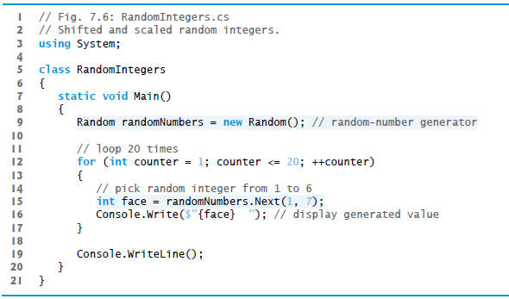
Figure 7.6 Shifted and Scaled Random Integers (1 of 2)

Slide 72

Figure 7.6 Shifted and Scaled Random Integers (2 of 2)

Slide 73
7.8.6 Rolling a Six-Sided Die (2 of 2)
The app in Figure 7.7 simulates 60,000,000 rolls of a die. Each integer from 1 to 6 should appear approximately 10,000,000 times.
The values produced by method Next enable the app to realistically simulate rolling a six-sided die.

Slide 74
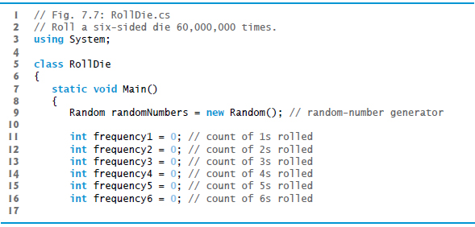
Figure 7.7 Roll a Six-Sided Die 60,000,000 Times (1 of 4)

Slide 75
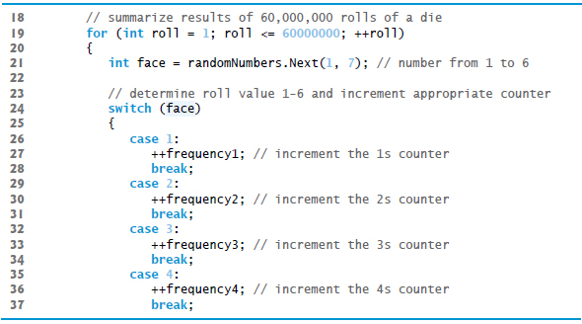
Figure 7.7 Roll a Six-Sided Die 60,000,000 Times (2 of 4)

Slide 76
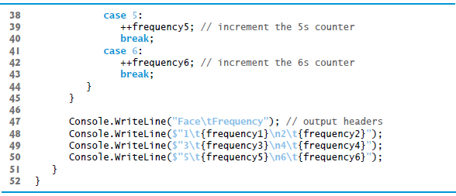
Figure 7.7 Roll a Six-Sided Die 60,000,000 Times (3 of 4)

Slide 77
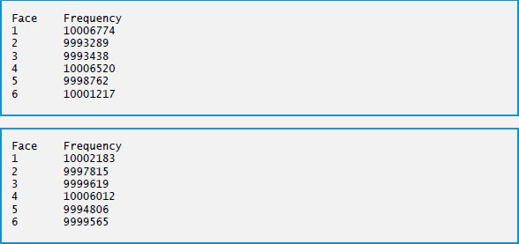
Figure 7.7 Roll a Six-Sided Die 60,000,000 Times (4 of 4)

Slide 78
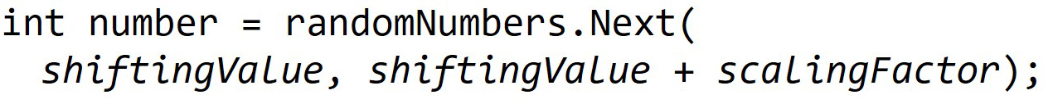
7.8.7 Scaling and Shifting Random Numbers (1 of 2)
Given two arguments, the next method allows scaling and shifting as follows:
shiftingValue specifies the first number in the desired range of consecutive integers.
scalingFactor specifies how many numbers are in the range.

Slide 79
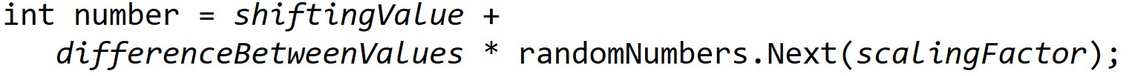
7.8.7 Scaling and Shifting Random Numbers (2 of 2)
To choose integers at random from sets of values other than ranges of consecutive integers, it is simpler to use the version of the Next method that takes only one argument:
shiftingValue specifies the first number in the desired range of values.
differenceBetweenValues represents the difference between consecutive numbers in the sequence.
scalingFactor specifies how many numbers are in the range.

Slide 80
7.8.8 Repeatability for Testing and Debugging
The calculation that produces the pseudorandom numbers uses the time of day as a seed value to change the sequence’s starting point.
You can pass a seed value to the Random object’s constructor.
Given the same seed value, the Random object will produce the same sequence of random numbers.

Slide 81
7.9 Case Study: A Game of Chance; Introducing Enumerations (1 of 3)
The rules of the dice game craps are as follows:
You roll two dice. Each die has six faces, which contain one, two, three, four, five and six spots, respectively. After the dice have come to rest, the sum of the spots on the two upward faces is calculated. If the sum is 7 or 11 on the first throw, you win. If the sum is 2, 3 or 12 on the first throw (called “craps”), you lose (i.e., “the house” wins). If the sum is 4, 5, 6, 8, 9 or 10 on the first throw, that sum becomes your “point.” To win, you must continue rolling the dice until you “make your point” (i.e., roll that same point value). You lose by rolling a 7 before making your point.
The program is shown in Figure 7.8.

Slide 82
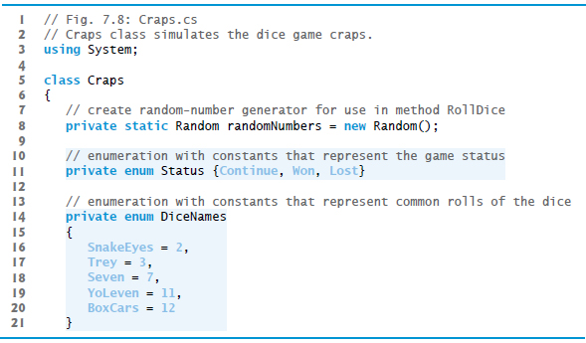
Figure 7.8 Craps Class Simulates the Dice Game Craps (1 of 8)

Slide 83
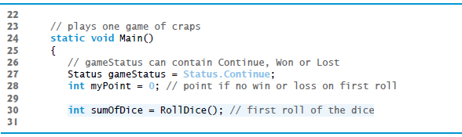
Figure 7.8 Craps Class Simulates the Dice Game Craps (2 of 8)

Slide 84
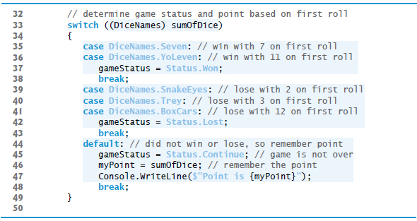
Figure 7.8 Craps Class Simulates the Dice Game Craps (3 of 8)

Slide 85
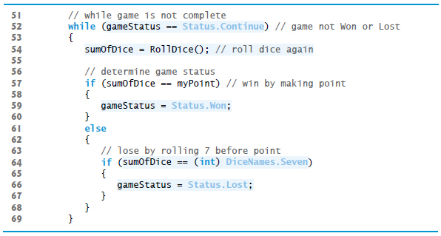
Figure 7.8 Craps Class Simulates the Dice Game Craps (4 of 8)

Slide 86

Figure 7.8 Craps Class Simulates the Dice Game Craps (5 of 8)

Slide 87
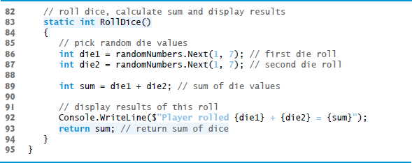
Figure 7.8 Craps Class Simulates the Dice Game Craps (6 of 8)

Slide 88
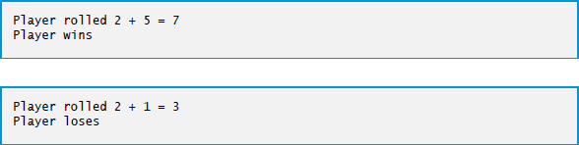
Figure 7.8 Craps Class Simulates the Dice Game Craps (7 of 8)

Slide 89
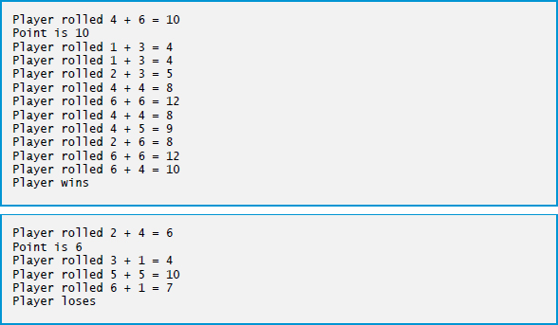
Figure 7.8 Craps Class Simulates the Dice Game Craps (8 of 8)

Slide 90
7.9.1 Case Study: A Game of Chance; Introducing Enumerations
A user-defined type called an enumeration declares a set of constants represented by identifiers, and is introduced by the keyword enum and a type name.
As with a class, braces ({ and }) delimit the body of an enum declaration. Inside the braces is a comma-separated list of enumeration constants.
The enum constant names must be unique, but the value associated with each constant need not be.
Variables of an enumeration type should be assigned only the values declared in the enumeration.

Slide 91
7.9 Case Study: A Game of Chance; Introducing Enumerations (2 of 3)
When an enum is declared, each constant in the enum declaration is a constant value of type int.
If you do not assign a value to an identifier in the enum declaration, the compiler will do so.
If the first enum constant is unassigned, the compiler gives it the value 0.
If any other enum constant is unassigned, the compiler gives it a value equal to one more than the value of the preceding enum constant.

Slide 92
Good Programming Practice 7.2
Using enumeration constants (like Status.Won, Status.Lost and Status.Continue) rather than literal integer values (such as 0, 1 and 2) can make code easier to read and maintain.

Slide 93
7.9 Case Study: A Game of Chance; Introducing Enumerations (3 of 3)
You can declare an enum’s underlying type to be byte, sbyte, short, ushort, int, uint, long or ulong by writing
typeName represents one of the integral simple types.
To compare a simple integral type value to the underlying value of an enumeration constant, you must use a cast operator.

Slide 94
7.10 Scope of Declarations (1 of 2)
The scope of a declaration is the portion of the app that can refer to the declared entity by its unqualified name.
The basic scope rules are as follows:
The scope of a parameter declaration is the body of the method in which the declaration appears.
The scope of a local-variable declaration is from the point at which the declaration appears to the end of the block containing the declaration.
The scope of a non-static method, property or field of a class is the entire body of the class.
If a local variable or parameter in a method has the same name as a field, the field is hidden until the block terminates.

Slide 95
7.10 Scope of Declarations (2 of 2)
The scope of a declaration is the portion of the app that can refer to the declared entity by its unqualified name.
The basic scope rules are as follows:
The scope of a parameter declaration is the body of the method in which the declaration appears.
The scope of a local-variable declaration is from the point at which the declaration appears to the end of the block containing the declaration.
The scope of a non-static method, property or field of a class is the entire body of the class.
If a local variable or parameter in a method has the same name as a field, the field is hidden until the block terminates.

Slide 96
Error-Prevention Tip 7.1
Use different names for fields and local variables to help prevent subtle logic errors that occur when a method is called and a local variable of the method hides a field of the same name in the class.

Slide 97
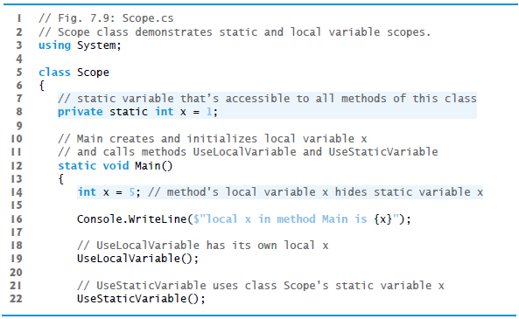
Figure 7.9 Scope Class Demonstrates Static- and Local-Variable Scopes (1 of 4)

Slide 98
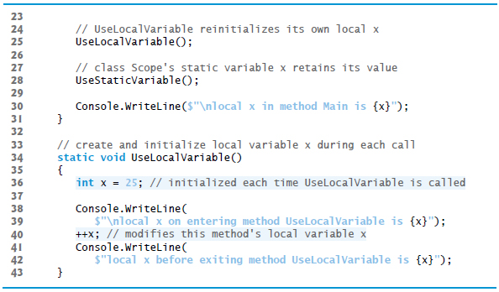
Figure 7.9 Scope Class Demonstrates Static- and Local-Variable Scopes (2 of 4)

Slide 99
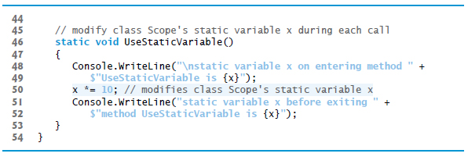
Figure 7.9 Scope Class Demonstrates Static- and Local-Variable Scopes (3 of 4)

Slide 100
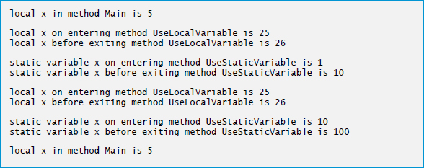
Figure 7.9 Scope Class Demonstrates Static- and Local-Variable Scopes (4 of 4)

Slide 101
7.11 Method-Call Stack and Activation Records
performs method calls, we first need to consider a data structure (i.e., collection of related data items) known as a stack.
Analogous to a pile of dishes.
When a dish is placed on the pile, it’s placed at the top—referred to as pushing the dish onto the stack.
Similarly, when a dish is removed from the pile, it’s removed from the top—referred to as popping the dish off the stack.
Stacks are known as last-in, first-out (L I F O) data structures—the last item pushed (inserted) on the stack is the first item popped (removed) from the stack.
To understand how

Slide 102
7.11.1 Method-Call Stack
One of the most important mechanisms for computer science students to understand is the method-call stack (sometimes referred to as the program-execution stack).
This data structure—working “behind the scenes”—supports the method call/return mechanism.
It also supports the creation, maintenance and destruction of each called method’s local variables.
Last-in, first-out (L I F O) behavior is exactly what a method needs in order to return to the method that called it.

Slide 103
7.11.2 Stack Frames (1 of 3)
As each method is called, it may, in turn, call other methods, which may, in turn, call other methods—all before any of the methods return.
Each method eventually must return control to the method that called it.
So, somehow, the system must keep track of the return addresses that each method needs in order to return control to the method that called it.
The method--call stack is the perfect data structure for handling this information.

Slide 104
7.11.2 Stack Frames (2 of 3)
Each time a method calls another method, an entry is pushed onto the stack.
This entry, called a stack frame or an activation record, contains the return address that the called method needs in order to return to the calling method.
If the called method returns instead of calling another method before returning, the stack frame for the method call is popped, and control transfers to the return address in the popped stack frame.
The same techniques apply when a method accesses a property or when a property calls a method.

Slide 105
7.11.2 Stack Frames (3 of 3)
The beauty of the call stack is that each called method always finds the information it needs to return to its caller at the top of the call stack.
If a method makes a call to another method, a stack frame for the new method call is simply pushed onto the call stack.
Thus, the return address required by the newly called method to return to its caller is now located at the top of the stack.

Slide 106
7.11.3 Local Variables and Stack Frames
Most methods have local variables—parameters and any local variables the method declares.
Local variables need to exist while a method is executing.
When a called method returns to its caller, the called method’s local variables need to “go away.”
The called method’s stack frame is a perfect place to reserve the memory for the called method’s local variables.
That stack frame exists as long as the called method is active.
When that method returns—and no longer needs its local variables—its stack frame is popped from the stack, and those local variables no longer exist.

Slide 107
7.11.4 Stack Overflow
The amount of memory in a computer is finite, so only a certain amount of memory can be used to store activation records on the method-call stack.
If more method calls occur than can have their activation records stored on the method-call stack, a fatal error known as stack overflow occurs—typically caused by infinite recursion.
[This is how the website stackoverflow.com got its name. This is a great website for getting answers to your programming questions.]

Slide 108
7.11.5 Method-Call Stack in Action
Now let’s consider how the call stack supports the operation of a Square method (lines 15–18 of Figure 7.10) called by Main (lines 8–12 see slide 111).

Slide 109
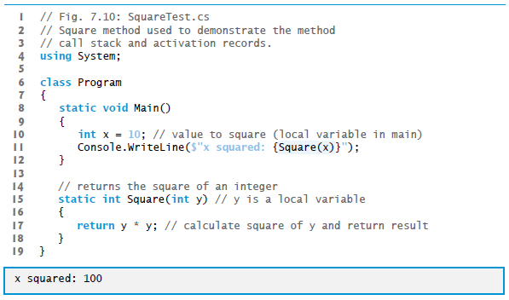
Figure 7.10 Square Method used to Demonstrate the Method-Call Stack and Activation Records

Slide 110
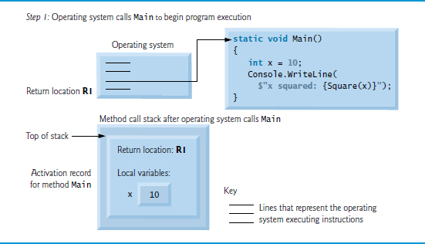
Figure 7.11 Method-Call Stack After the Operating System Calls main to Execute the Program

Slide 111
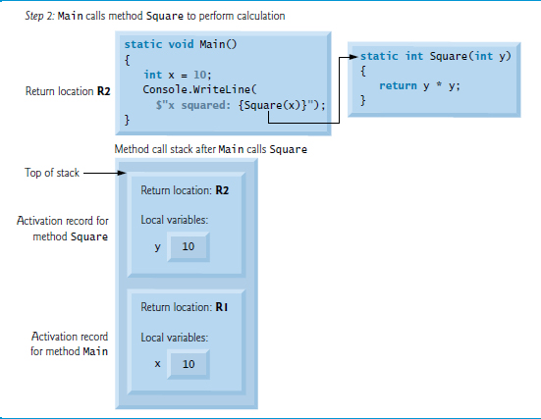
Figure 7.12 Method-Call Stack After the Main Calls square to Perform the Calculation

Slide 112
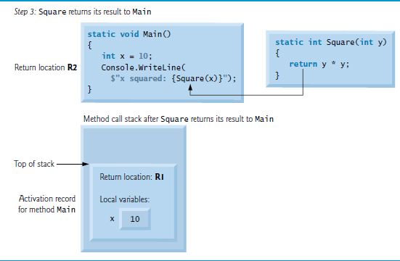
Figure 7.13 Method-Call Stack After the Method square Returns to Main

Slide 113
7.12 Method Overloading
Methods of the same name can be declared in the same class, or overloaded, as long as they have different sets of parameters.
When an overloaded method is called, the
compiler selects the appropriate method by examining the number, types and order of the arguments in the call.
Method overloading is used to create several methods with the same name that perform the same tasks, but on different types or numbers of arguments.

Slide 114
7.12.1 Declaring Overloaded Methods
Class MethodOverload (Figure 7.10 see slide 109) includes two overloaded versions of a method called Square.
Although these methods have the same name and similar parameter lists and bodies, you can think of them simply as different methods.
It may help to think of the method names as “Square of int” and “Square of double,” respectively

Slide 115
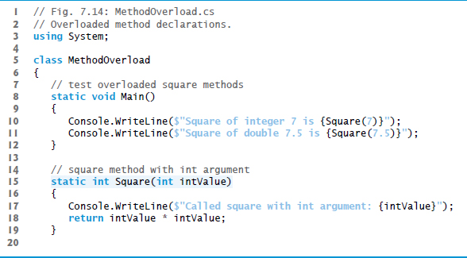
Figure 7.14 Overloaded Method Declarations (1 of 2)

Slide 116
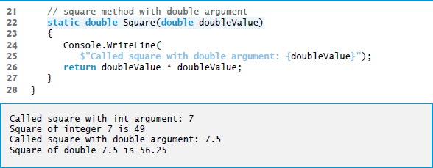
Figure 7.14 Overloaded Method Declarations (2 of 2)

Slide 117
7.12.2 Distinguishing Between Overloaded Methods
The compiler distinguishes overloaded methods by their signature—a combination of the method’s name and the number, types and order of its parameters.

Slide 118
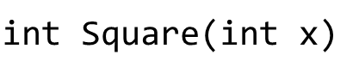
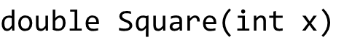
7.12.3 Return Types of Overloaded Methods
Method calls cannot be distinguished by return type.
If in a class you define overloaded methods with the following headers:
The compiler generates the following error for the second Square method:
Type ‘MethodOverloadError’ already defines a member called ‘Square’ with the same parameter types
Overloaded methods can have the same or different return types if the parameter lists are different. Also, overloaded methods need not have the same number of parameters

Slide 119
Common Programming Error 7.9
Declaring overloaded methods with identical parameter lists is a compilation error regardless of whether the return types are different.

Slide 120
7.13 Optional Parameters (1 of 4)
Methods can have optional parameters that allow the calling method to vary the number of arguments to pass.
An optional parameter specifies a default value that’s assigned to the parameter if the optional argument is omitted.
You can create methods with one or more optional parameters.
All optional parameters must be placed to the right of the method’s non-optional parameters.

Slide 121
Common Programming Error 7.10
Declaring a non-optional parameter to the right of an optional one is a compilation error.

Slide 122
7.13 Optional Parameters (2 of 4)
When a parameter has a default value, the caller has the option of passing that particular argument.
For example, the method header
specifies an optional second parameter.
Any call to Power must pass at least an argument for the parameter baseValue, or a compilation error occurs.

Slide 123
7.13 Optional Parameters (3 of 4)
Optionally, a second argument (for the exponentValue parameter) can be passed to Power. Consider the following calls to Power:
Power()
Power(10)
Power(10, 3)
The first generates a compilation error because this method requires a minimum of one argument.
The second is valid because one argument (10) is being passed—the optional exponentValue is not specified in the method call.
The last call is also valid—10 is passed as the required argument and 3 is passed as the optional argument.

Slide 124
7.13 Optional Parameters (4 of 4)
In the call that passes only one argument (10), parameter exponentValue defaults to 2, which is the default value specified in the method’s header.
Each optional parameter must specify a default value by using an equal (=) sign followed by the value.
Figure 7.15 demonstrates an optional parameter. The program calculates the result of raising a base value to an exponent.

Slide 125
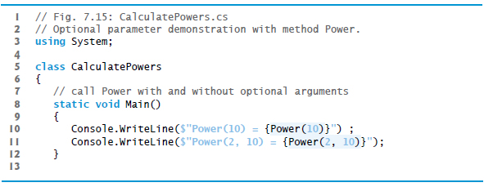
Figure 7.15 Optional Parameter Demonstration with Method Power (1 of 2)

Slide 126
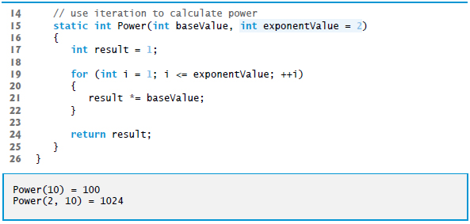
Figure 7.15 Optional Parameter Demonstration with Method Power (2 of 2)

Slide 127
7.14 Named Parameters (1 of 2)
provides a feature called named parameters, which enable you to call methods that receive optional parameters by providing only the optional arguments you wish to specify.
Explicitly specify the parameter’s name and value—separated by a colon (:)—in the argument list of the method call.
For example:
sets the time to 12:00:22
t.SetTime (hour: 12, second: 22);

Slide 128
7.14 Named Parameters (2 of 2)
The compiler assigns parameter hour the argument 12 and parameter second the argument 22.
The parameter minute is not specified, so the compiler assigns it the default value 0.
It’s also possible to specify the arguments out of order when using named parameters. The arguments for the required parameters must always be supplied.

Slide 129
7.15 C sharp 6 Expression Bodied Methods (1 of 3)
6 introduces a new concise syntax for:
methods that contain only a return statement that returns a value
read-only properties in which the get accessor contains only a return statement
methods that contain single statement bodies.

Slide 130
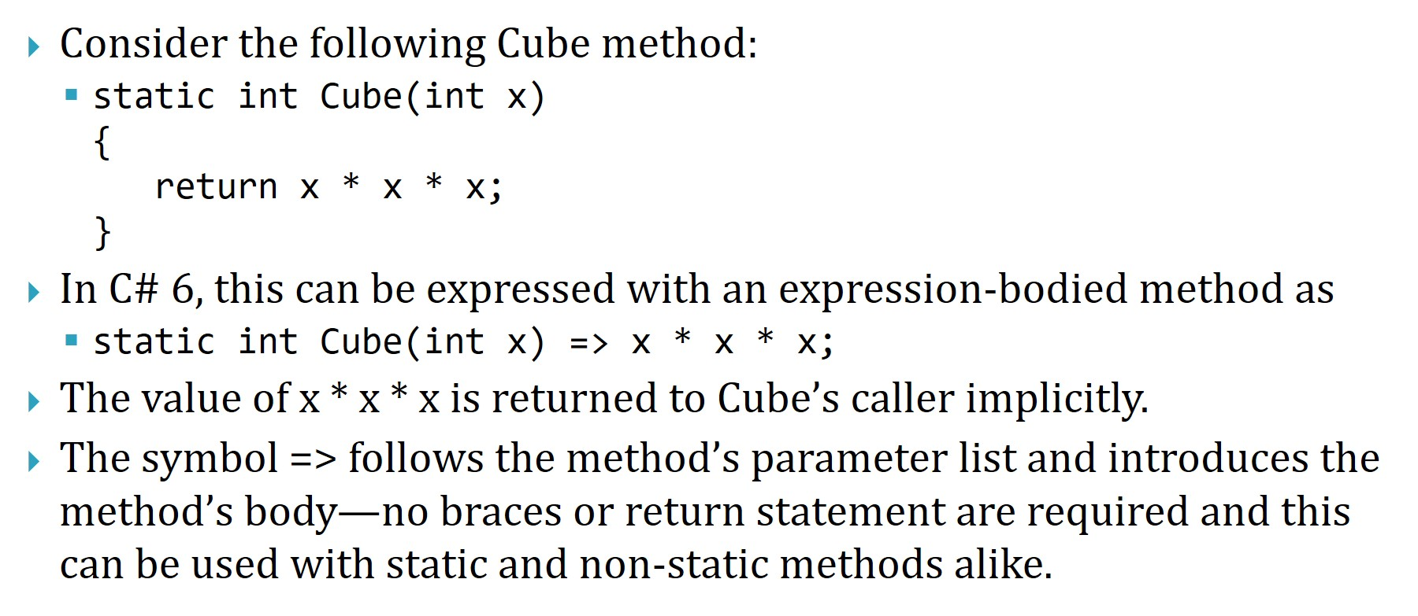
7.15 C sharp 6 Expression Bodied Methods (2 of 3)
Consider the following Cube method:
In
6, this can be expressed with an expression-bodied method as
The value of
is returned to Cube’s caller implicitly.
The symbol
follows the method’s parameter list and introduces the method’s body—no braces or return statement are required and this can be used with static and non-static methods alike.

Slide 131
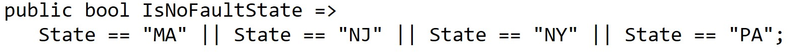
7.15 C sharp 6 Expression Bodied Methods (3 of 3)
does not have a value (e.g., a call to a method that returns void), the expression-bodied method must return void.
Similarly, a read-only property can be implemented as an expression-bodied property.
The following reimplements the IsNoFaultState property in Figure 6.11 to return the result of a logical expression:
If the expression to the right of

Slide 132
7.16 Recursion (1 of 2)
A recursive method is a method that calls itself.
A recursive method is capable of solving only the base case(s).
Each method call divides the problem into two conceptual pieces: a piece that the method knows how to do and a recursive call, or recursion step that solves a smaller problem.
A sequence of returns ensues until the original method call returns the result to the caller.

Slide 133
7.16.2 Recursive Factorial Calculations (1 of 2)
A recursive declaration of the factorial method is arrived at by observing the following relationship:
Figure 7.16 shows the values returned from each recursive call in 5! to its caller until the value is calculated and returned.

Slide 134
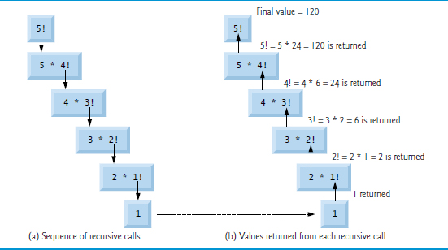
Figure 7.16 Recursive Evaluation of 5!.

Slide 135
7.16.2 Recursive Factorial Calculations (2 of 2)
Figure 7.14 uses recursion to calculate and display the factorials of the integers from 0 to 10.

Slide 136
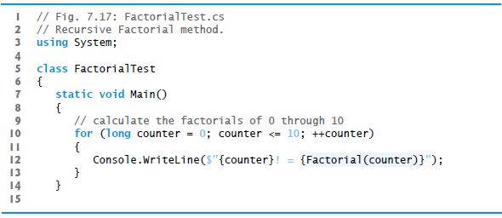
Figure 7.17 Recursive Factorial Method (1 of 3)

Slide 137
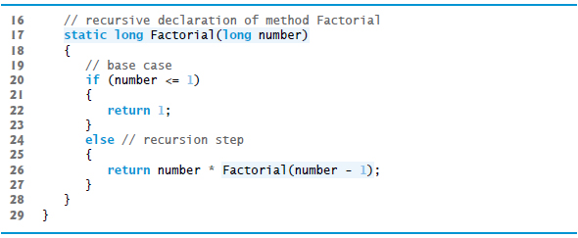
Figure 7.17 Recursive Factorial Method (2 of 3)

Slide 138
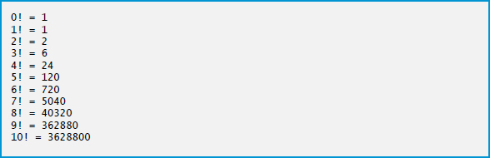
Figure 7.17 Recursive Factorial Method (3 of 3)

Slide 139
7.16 Recursion (2 of 2)
First, test to determine whether the terminating condition is true.
The recursive call solves a slightly simpler problem than the original calculation.

Slide 140
Common Programming Error 7.11
Either omitting the base case or writing the recursion step incorrectly so that it does not converge on the base case will cause infinite recursion, eventually exhausting memory. This error is analogous to the problem of an infinite loop in an iterative (nonrecursive) solution.

Slide 141
7.17 Value Types vs. Reference Types
are divided into two categories—value types and reference types.
Types in
simple types (like int, double and decimal) are all value types.
A variable of a value type simply contains a value of that type.
Figure 7.18 shows an int variable named count that contains the value 7.

Slide 142

Figure 7.18 Value-Type Variable

Slide 143
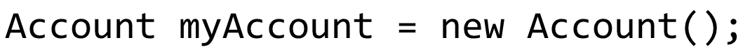
7.17 Value Types vs. Reference Types (1 of 2)
A variable of a reference type (also called a reference) contains the location where the data referred to by that variable is stored.
Such a variable is said to refer to an object in the program. For example, the statement
creates an object of our class Account (presented in Chapter 4), places it in memory and stores the object’s reference in variable myAccount of type Account (Figure 7.19).

Slide 144
7.17 Value Types vs. Reference Types (2 of 2)
Reference-type instance variables are initialized by default to null.
A string variable with the value null is not an empty string, which is represented by "" or string.Empty.
The value null represents a reference that does not refer to an object, whereas the empty string is a string object that does not contain any characters.

Slide 145
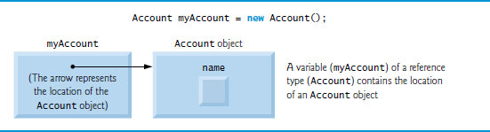
Figure 7.19 Reference-Type Variable

Slide 146
Software Engineering Observation 7.5
A variable’s declared type (e.g., int or Account) indicates whether the variable is of a value type or a reference type. If a variable’s type is one of the simple types (Appendix B), an enum type or a struct type (which we introduce in Section 10.13), then it’s a value type. Classes like Account are reference types.

Slide 147
7.18 Passing Arguments: Pass-By-Value vs. Pass-By-Reference (1 of 3)
Two ways to pass arguments to functions in many programming languages are pass-by-value and pass-by-reference.
When an argument is passed by value
a copy of its value is made and passed to the called function.
When an argument is passed by reference, the caller gives the method the ability to access and modify the caller’s original variable.

Slide 148
7.18 Passing Arguments: Pass-By-Value vs. Pass-By-Reference (2 of 3)
To pass an object by reference into a method, simply provide as an argument in the method call the variable that refers to the object.
In the method body, the parameter will refer to the original object in memory, so the called method can access the original object directly.
Passing a value-type variable to a method passes a copy of the value.

Slide 149
7.18 Passing Arguments: Pass-By-Value vs. Pass-By-Reference (3 of 3)
Passing a reference-type variable passes the method a copy of the actual reference that refers to the object.
The reference itself is passed by value, but the method can still use the reference it receives to modify the original object in memory.
A return statement returns a copy of the value stored in a value-type variable or a copy of the reference stored in a reference-type variable.
In effect, objects are always passed by reference.

Slide 150
Performance Tip 7.1
A disadvantage of pass-by-value is that, if a large data item is being passed, copying that data can take a considerable amount of execution time and memory space.

Slide 151
Performance Tip 7.2
Pass-by-reference improves performance by eliminating the pass-by-value overhead of copying large objects.

Slide 152
Software Engineering Observation 7.6
Pass-by-reference can weaken security; the called method can corrupt the caller’s data.

Slide 153
7.18.1 Ref and out Parameters
Applying the ref keyword to a parameter declaration allows you to pass a variable to a method by reference
The ref keyword is used for variables that already have been initialized in the calling method.
Preceding a parameter with keyword out creates an output parameter.
This indicates to the compiler that the argument will be passed by reference and that the called method will assign a value to it.
A method can return multiple output parameters.

Slide 154
Common Programming Error 7.12
When a method call contains an uninitialized variable as an argument to a ref parameter, the compiler generates an error.

Slide 155
Common Programming Error 7.13
If the method does not assign a value to the out parameter in every possible path of execution, the compiler generates an error. Also, reading an out parameter before it's assigned a value is also a compilation error.

Slide 156
Software Engineering Observation 7.7
A method can return only one value to its caller via a return statement, but can return many values by specifying multiple output (ref and/or out) parameters.

Slide 157
Software Engineering Observation 7.8
does not allow you to choose whether to pass each argument by value or by reference. Value types are passed by value. Objects are not passed to methods; rather, references to objects are passed—the references themselves are passed by value. When a method receives a reference to an object, the method can manipulate the object directly, but the reference value cannot be changed to refer to a new object.
By default,

Slide 158
7.18.2 Demonstrating Ref, out and Value Parameters (1 of 2)
The app in Figure 7.20 uses the ref and out keywords to manipulate integer values.
The class contains three methods that calculate the square of an integer.

Slide 159
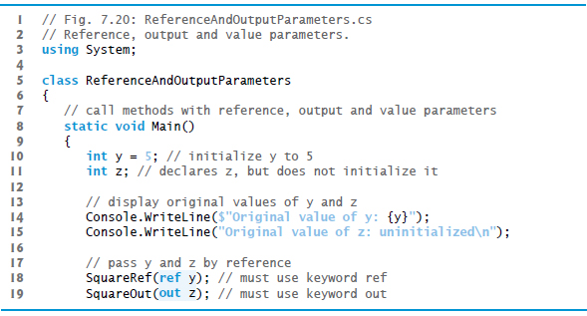
Figure 7.20 Reference, Output and Value Parameters (1 of 4)

Slide 160
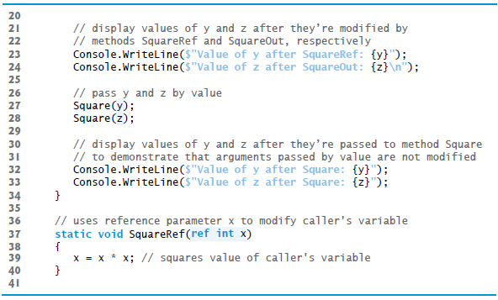
Figure 7.20 Reference, Output and Value Parameters (2 of 4)

Slide 161
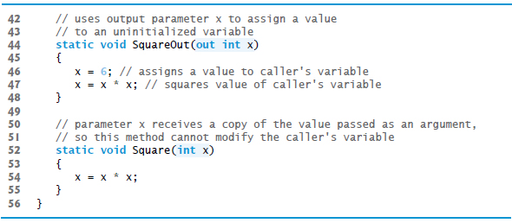
Figure 7.20 Reference, Output and Value Parameters (3 of 4)

Slide 162
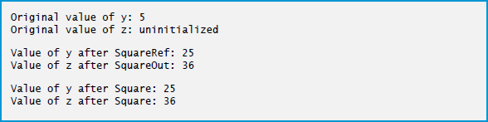
Figure 7.20 Reference, Output and Value Parameters (4 of 4)

Slide 163
7.18.2 Demonstrating Ref, out and Value Parameters (2 of 2)
When you pass a variable to a method with a reference parameter, you must precede the argument with the same keyword (ref or out) that was used to declare the reference parameter.

Slide 164
Common Programming Error 7.14
The ref and out arguments in a method call must match the ref and out parameters specified in the method declaration; otherwise, a compilation error occurs.

Slide 165

Copyright

